Slide 1
Retrieval-Augmented Generation (RAG)
Présenté par Boudjenane Zoubida Asmaa

Slide 2

Introduction
Large language models (LLMs) have seen significant advancements but face challenges, particularly in tasks that demand extensive knowledge or deal with queries beyond their training data. These limitations often result in “hallucinations.” To address this, Retrieval-Augmented Generation (RAG) supplements LLMs by retrieving relevant document chunks from external knowledge sources based on semantic similarity. By doing so, RAG helps reduce factual errors, allowing LLMs to produce more accurate content. This has led to the widespread adoption of RAG, particularly in chatbots and other real-world applications,

Slide 3
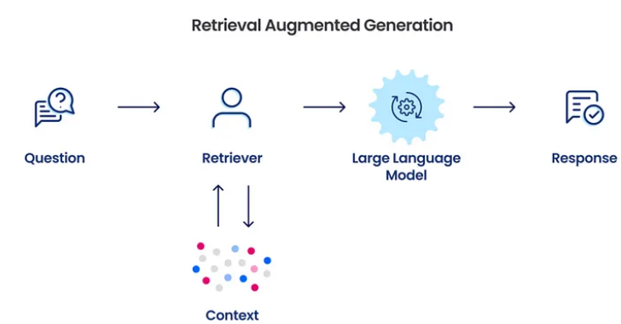
Definition of RAG
Retrieval-Augmented Generation (RAG) is a technique that leverages the strengths of pre-trained large language models (LLMs) and external data sources. By merging the generative abilities of LLMs like GPT-3 or GPT-4 with the accuracy of specialized data search mechanisms, RAG systems can generate more sophisticated and contextually relevant responses

Slide 4
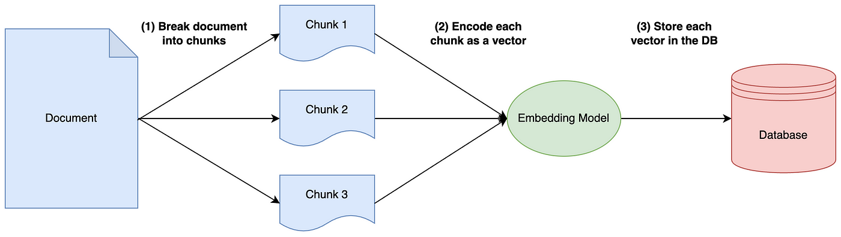
How does Retrieval-Augmented Generation work?
Without RAG, the LLM generates a response based only on the knowledge it was trained on or already possesses. In contrast, RAG incorporates an information retrieval mechanism that uses the user input to fetch relevant data from an external source. Both the user query and the retrieved information are then provided to the LLM,
Ingestion Process
Chunking : Breaks down large documents into smaller, meaningful segments to enhance retrieval accuracy. eg Sliding Window , Sentence/Paragraph Segmentation: Use NLP tools (e.g., spaCy or NLTK)
Embedding : Converts text chunks into vector representations that capture semantic meaning. e.g Word Embeddings (Word2Vec, GloVe), Sentence Embeddings (ARBERT, BERT):
Indexing : After embedding, store these vectors in a database or index like FAISS for fast similarity search.

Slide 5
2. Retrieval Process
Query Embedding : Convert the user query into a vector representation using the same embedding model as used in the ingestion process (e.g., BERT) .
Similarity Search : Compare the query embedding with stored embeddings in the index (e.g., FAISS, HNSW) to find the most relevant chunks.
Techniques: Cosine Similarity , Dot Product , ANN (Approximate Nearest Neighbors)
Top-K Selection : the system identifies the most relevant information chunksbased on similarity scores to feed into the language model
Output Relevant Chunks : Pass the top-k ranked chunks to the language model for response generation
3. Generation Process
The relevant retrieved information, along with the original query, is fed into the language model. The model then generates a response by combining the retrieved content with its own pre-trained knowledge.

Slide 6
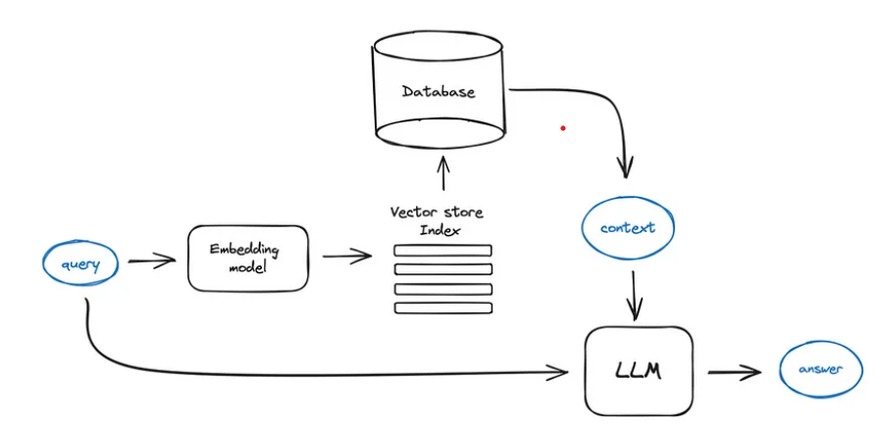
RAG architecture

Slide 7
Challenge in Retrieval Systems
In retrieval systems, selecting the number of top results (K) to retrieve presents a significant challenge due to the inherent trade-offs between small K and large K values
Small K (e.g., K = 5 or 10)
- High risk of missing relevant information.
- Fails to capture diverse or less obvious matches, leading to incomplete responses.
Large K (e.g., K = 100 or more)
- Increases noise by including irrelevant results.
- Higher computational cost during both retrieval and ranking stages.
The static selection of K creates a rigid trade-off between retrieval quality and efficiency:

Slide 8
Current Solutions
Static K Selection
Description: A retrieval method that ranks all items in a dataset by their relevance to a query and selects the top K results
Example : Many traditional search engines use static K for retrieving top results.
Algorithm: - brute force method that systematically compares the query to every item in the dataset to find the most relevant results.
-Exact Nearest Neighbor Search :technique that identifies the closest items to a query based on a defined distance metric (e.g., Euclidean distance, cosine similarity)
.Limitation :
- Not adaptive to query complexity or dataset variability.
- Risk of under-fetching (small K) or over-fetching (large K) relevant results.
- slow for high-dimensional or large-scale data.
Impact:
- Results may miss important information or include unnecessary noise, reducing retrieval efficiency

Slide 9
Proposed Solution: Dynamic Candidate Selection
Dynamic Candidate Selection :
Description: This algorithm dynamically adjusts the candidate selection process to overcome the limitations of static K approaches. By leveraging component-level embeddings and a Mixture of Logits (MoL) scoring mechanism, it refines the retrieval threshold and selects the top-k items adaptively,
Steps :
Initialize Candidate Set: Start with an empty candidate set.
Generate Component-Level Embeddings: Create embeddings for both query and dataset items.
Initial Retrieval : Retrieve candidates with relevance scores exceeding an initial threshold Tinitl
Dynamic Threshold Adjustment:
Compute MoL scores(inner products of these P pairs)to assess the importance of each item.
Update the threshold to TadaptiveT_{adaptive}​ based on current relevance scores.
Refine Candidate Set: Add more relevant items using the adaptive threshold.
Exact Top-K Selection: Sort and select the top-k items based on MoL scores.
Return Final Results: Output the most relevant top-k items.

Slide 10
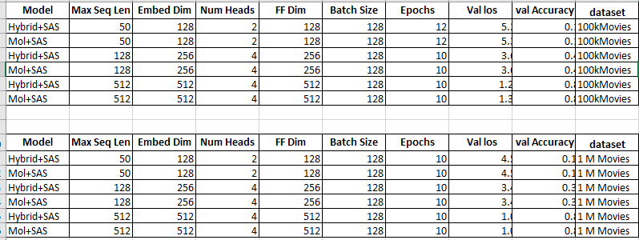
Evaluation
We assess the performance of the MoL-based learned similarity metric and the efficiency of our retrieval algorithms. The evaluation focuses on a traditional retrieval task within recommendation systems, utilizing the 1M and 100k subsets of the MovieLens dataset.

Slide 11
Advantages
Addresses Static Limitations
Improves Relevance
Scalable
Dynamically adapts K and thresholds, reducing over-fetching and under-fetching.
scoring items based on weighted features, the algorithm ensures that the most relevant items are given higher priority
The algorithm is designed to scale well with both large datasets and diverse queries.

Slide 12
Conclusion:
The proposed Dynamic Candidate Selection algorithm addresses the limitations of tr
aditional static retrieval approaches by dynamically adjusting key parameters such as K and relevance thresholds. This adaptability improves retrieval efficiency, ensuring that the system avoids both over-fetching and under-fetching of results. The incorporation of component-level embeddings and the Mixture of Logits (MoL) scoring mechanism further enhances relevance by prioritizing important features and better matching items to the query context. Additionally, the system is highly scalable, efficiently handling diverse queries across various datasets and domains

